Slide 1
DOM Parser
Service-Oriented Software Engineering
Software Institute
Nanjing University
Bei Jia

Slide 2
DOM Basics
Document Object Model
  API that defines the objects present in an XML document and the methods and properties that are used to define them
DOM parser reads and loads an entire XML document into memory as a tree structure
DOM stresses an Object Model over a Data Model
  Objects protect their data using accessors methods
  Data models are centered around the data
Every object in the DOM API is considered a node
  Data is encapsulated within the node
  Special node subtypes for each data type

Slide 3
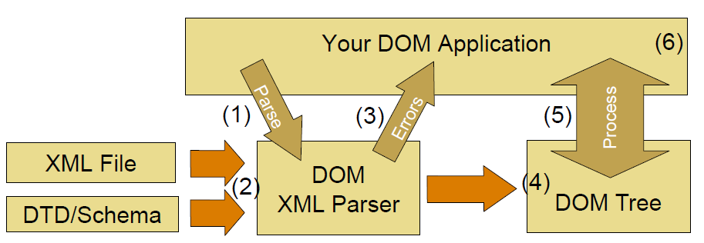
DOM Processing Overview
Basic DOM Processing Flow
  1. Application creates a DOM Parser
  2. Parser reads in XML and any vocabulary
  3. Parser returns any errors to the application
  4. Parser generates a DOM Tree
  5. Application can read, write, or update the DOM Tree
  6. Application writes final XML to output

Slide 4
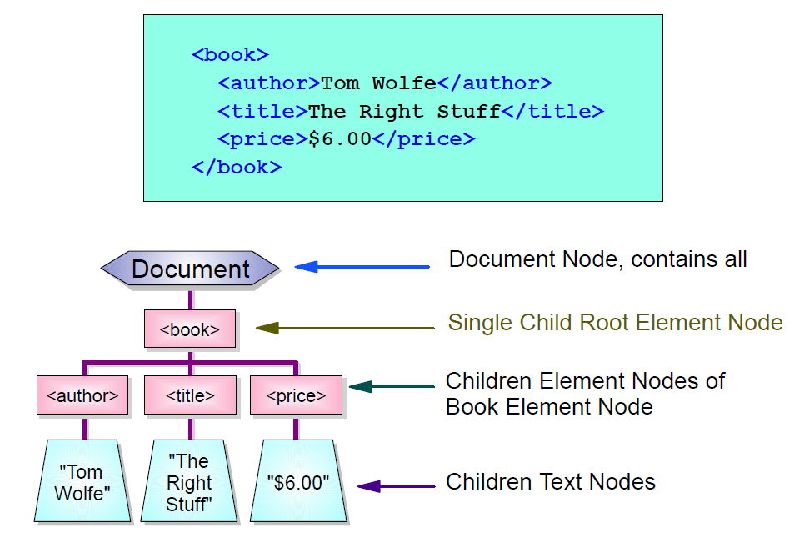
DOM Abstract Tree Model

Slide 5
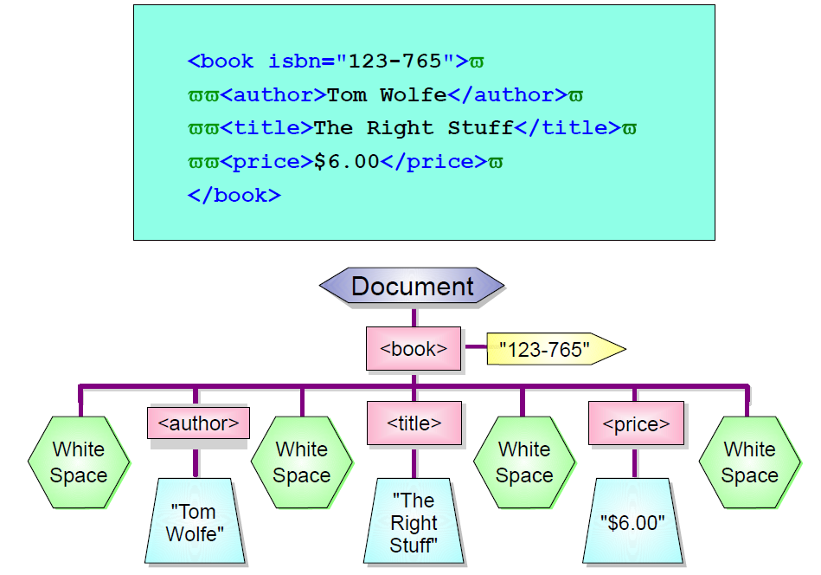
Real DOM Tree Structure

Slide 6
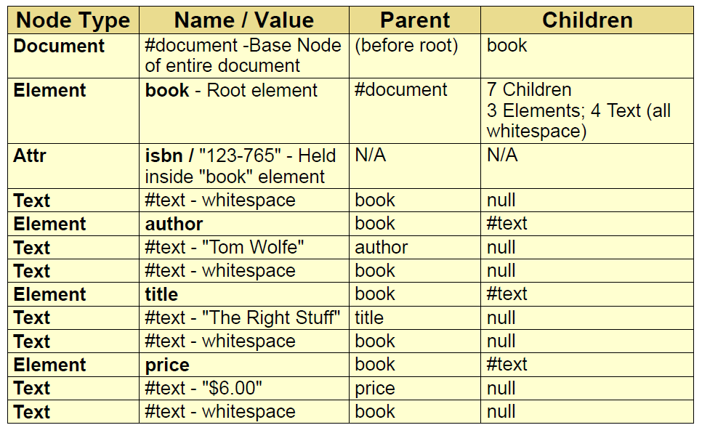
Node Contents and Values for DOM Tree
Each node in a DOM tree contains attributes describing names, values, and parent/child/sibling relationships

Slide 7
Node Interface
Everything is a node in the DOM
Contains attributes and method for determining:
  Node name
  Type of node (element, text, attribute, and so forth)
  Relationships (parent, siblings, children)
Has methods for modifying structure:
  Adding children
  Replacing children
  Deleting children
The top-level node is called the DocumentElement Node:
  Represents the entire document
  Only a single element child node is allowed ("root")
  May have other children nodes (comments, PIs, and so forth)
A Node Interface Model is used to access the individual elements in the node tree

Slide 8
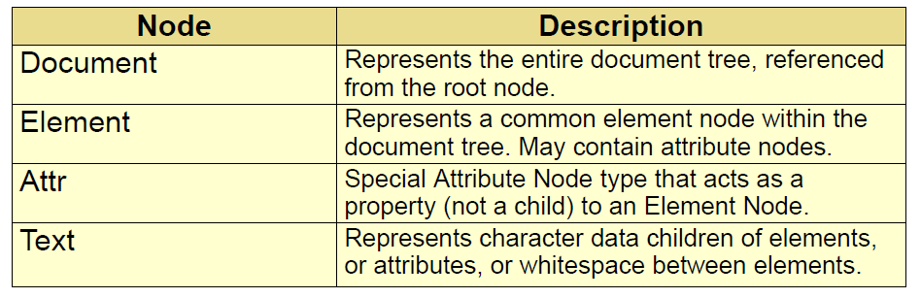
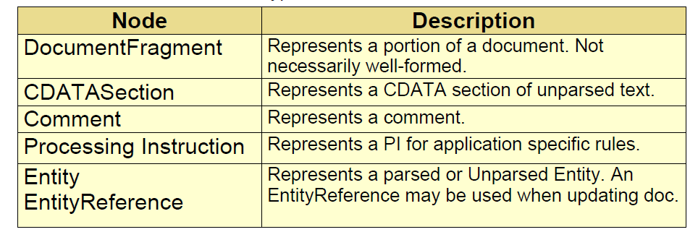
Node Types
The following are some common node types
And some less common node types

Slide 9
DOM Application Structure
Parser creation
  Define factory
  Configure parser settings
  Create parser
  Parse document
Dealing with parsing errors
  Exceptions
  SAX-style error handling
Navigating the document
  Traversing document tree
Processing the document
  Modifying contents
  Modifying structure
  Moving nodes

Slide 10

Parser Creation: Four Steps
Step 1: Create new instance of DocumentBuilderFactory
  JAXP dynamically locates the real DOM implementation
  Application doesn't care what DOM parser is used
Step 2: Set any desired parsing options
  Some behaviors of the parser can be altered
  All available features and properties are shown later
Step 3: Create a DocumentBuilder from the factory
  Multiple parsers can be generated from a single factory
Step 4: Parse the XML file and obtain the Document
  The parse() method does it all in one call

Slide 11
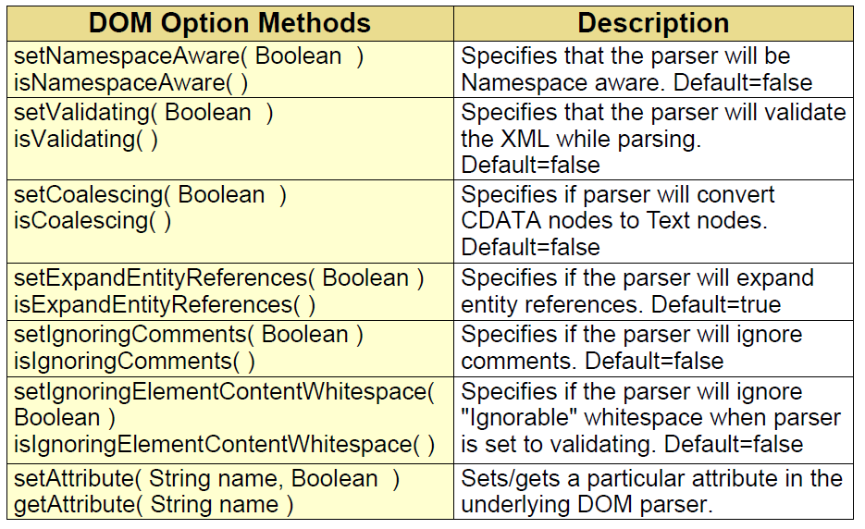
Setting DOM Options
Option settings are made to the DocumentBuilderFactory class prior to generating an implementing parser

Slide 12
Exception Handling during Parsing
Many things can go wrong when parsing a document
Common exceptions that can be thrown are:
  javax.xml.parsers.ParserConfigurationException
    Thrown when set to a bad configuration
  java.lang.IllegalArgumentException
    Thrown when bad arguments passed
  java.io.IOException
    Thrown when XML source cannot be opened
  org.xml.sax.SAXException
    Thrown when XML contains errors
A SAX style error handler can be supplied to the DocumentBuilder using the setErrorHandler() method

Slide 13
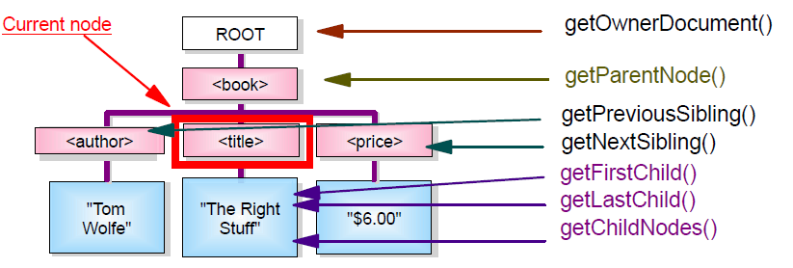
Navigating the Document Tree
Once a document is obtained from the parser, it is available for processing
  Begin at the root element node
  Recursively walk through the tree
Every node has getter methods to its relatives
  Document, Parent, Children, Siblings

